Slide 1
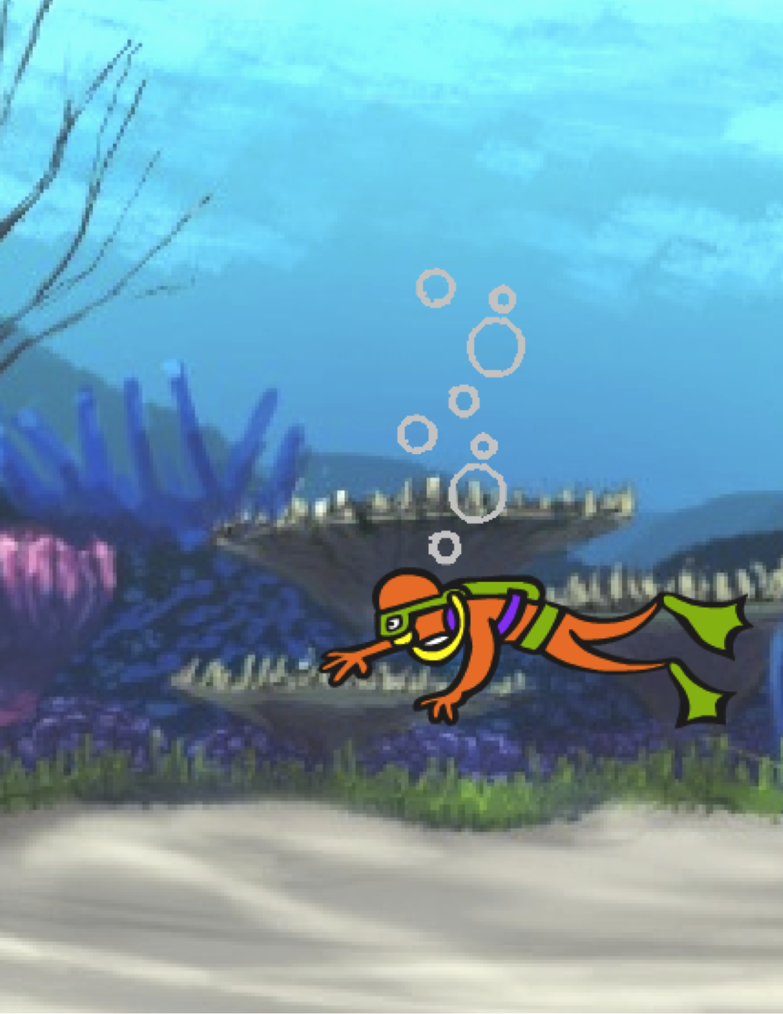
UNIT 5
DIVING DEEPER
WHAT’S INCLUDED
YOU ARE HERE
KNOW WANT LEARN 92
ROUND TWO 94
ADVANCED CONCEPTS 96
HARDWARE & EXTENSIONS 100
ACTIVITY DESIGN 102
MY DEBUG IT! 106
0
1
2
3
4
5
6
89
Notes:
<numéro>

Slide 2

UNIT 5
OVERVIEW
THE “BIG IDEA”
THE “BIG IDEA”
After the release of the previous version of the guide, a common piece of feedback that we received from teachers was that they (and the learners they support) wanted more “catch-up” time, time to linger, revisit, and extend the ideas and projects they had created in previous units. In response, we added this “Diving Deeper” unit.
Whether pushing ahead with advanced concepts and practices or revisiting previous experiences, this is an opportunity for learners to engage in a moment of contemplation and reflection. What isn’t as clear as it could be? What do they still want to know about Scratch? How might others help them – and how might they help others?
This is also an opportunity for you, as educator, to engage in similar acts of contemplation and reflection. What has surprised you? What has made you uncomfortable? What would you want to do differently next time? Why?
LEARNING OBJECTIVES
KEY WORDS, CONCEPTS, & PRACTICES
Learners will:
reflect on past experiences to self-assess current learning goals and needs
create a self-remix by extending a previously started project
be introduced to various hardware extensions that connect Scratch to the physical world
gain more fluency in computational concepts and practices by exploring the newest Scratch features (video sensing, cloning)
experiment with designing learning experiences for others
video sensing
cloning
peer interviews
hardware
extensions
NOTES
Not finding what you’re looking for? Feel free to remix, reuse, and reimagine any of the activities in this guide to make it work best for you and your learners.
Search for lesson plans, activities, and resources designed for a specific curricular area on the ScratchEd website:
http://scratched.gse.harvard.edu
90
Notes:
<numéro>

Slide 3
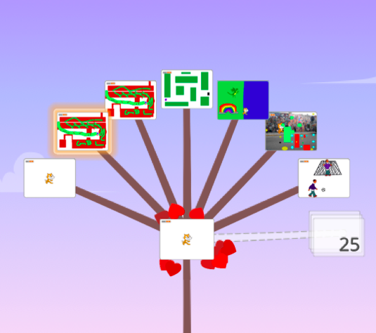
CHOOSE YOUR OWN ADVENTURE
Rather than focusing on a particular theme or genre like the three previous units, this unit is intended to create a space for reviewing and reflecting on prior work. This unit’s activities are especially flexible, diving deeper into creative computing by revisiting challenges, extending skills, or refining practices.
Begin by inviting students to review their past work and engage in self-assessment of their learning goals in the Know Want Learn activity.
Then, encourage students to dive deeper into Scratch by choosing which follow-up activities to pursue.
POSSIBLE PATH
SESSION 1
SESSION 2
SESSION 3
SESSION 4
SESSION 5
KNOW
WANT LEARN
ROUND TWO
HARDWARE & EXTENSIONS
ADVANCED CONCEPTS
ACTIVITY DESIGN
MY DEBUG IT!
What do you know?
What do you
want to know? What have you learned?
Remix a past project, go back to a missed activity, or challenge yourself to learn something new.
Creating with Scratch can go beyond what happens on the screen.
Create a project that explores video sensing
or cloning.
Design a learning experience for others to try.
Create your own Debug It! program and see if others can solve it.
91

Slide 4


KNOW WANT
LEARN
OBJECTIVES
By completing this activity, students will:
reflect on past projects and experiences
self-assess current knowledge and learning goals
pursue personal learning interests in a self-directed research activity
UNIT 5 ACTIVITY
_{SUGGESTED TIME}
30–45 MINUTES
ACTIVITY DESCRIPTION
RESOURCES
In this self-directed learning activity, students will reflect on current understandings and build new knowledge based on their interests. Optionally, have the Know Want Learn worksheet available to guide students.
Ask students to reflect on what they know already and what they want to know next about Scratch and creative computing. Guide students in answering the first two reflection prompts in their design journals or using the Know Want Learn self-assessment worksheet. Next, give students time to pursue learning interests from their “What do you want to know?” responses. Finally, have students respond to the third and fourth reflection prompts in their design journals or using the Know Want Learn worksheet.
Help students share their reflections and learning interests with one another. We recommend peer interviews: divide students into pairs and have them take turns interviewing one another about their processes of reflection, self-assessment, and research.
Know Want Learn worksheet
Scratch Wiki
http://wiki.scratch.mit.edu
Scratch Discussion Forums
http://scratch.mit.edu/discuss
Scratch FAQ
http://scratch.mit.edu/help/faq
REFLECTION PROMPTS
What do you know?
What do you want to know?
What did you learn?
What were your strategies for investigating what you wanted to know?
REVIEWING STUDENT WORK
Were students able to learn what they wanted to know?
What strategies and resources did they employ?
NOTES
NOTES TO SELF
Help students find and use other resources during their research such as leveraging knowledgeable peers, posing questions to family members and friends, or posting a question in the Scratch discussion forums.
92
Notes:
<numéro>

Slide 5
KNOW WANT
LEARN
NAME: ____________________________________________________
What do you know about creative computing & scratch? What do you want to know next? This activity is an opportunity for you to consider which areas of Scratch you feel comfortable navigating (What do I know?) and which areas you would like to explore further (What do I want to know?). Use different resources around you to investigate what you want to know, and then share your findings (What did I learn?).
WHAT DO I KNOW?
Reflecting on your design experiences so far, write down what you know about Scratch and creative computing.
WHAT DO I WANT TO KNOW?
Based on your personal interests, generate a list of things you want to find out more about or discover next.
WHAT DID I LEARN?
TIPS & TRICKS
Gather resources to investigate items from the list you created above, and then share what you learned from your research.
Notes:
<numéro>

Slide 6

ROUND TWO
OBJECTIVES
By completing this activity, students will:
have the opportunity to create a self-remix of past work or spend time on a unit activity that was previously skipped or not completed
UNIT 5 ACTIVITY
_{SUGGESTED TIME}
45–60 MINUTES
ACTIVITY DESCRIPTION
RESOURCES
Optionally, have the activity handouts from Units 0-5 available to guide students.
Give students self-directed time to:
1. reimagine or extend a past project by creating a self-remix: a remix of one’s own project.
2. revisit and work on a previous unit activity that was either skipped or not completed.
Encourage students to share their self-remixes or activity outcomes with one another. We suggest using pair-share or design demo.
Invite students to think back on the design process by responding to the reflection prompts in their design journals or in a group discussion.
Units 0-5 handouts
REFLECTION PROMPTS
Why did you choose that project or activity to work on?
What would you do if you had more time?
REVIEWING STUDENT WORK
Did students create self-remixes or work on activities?
What did you learn about your students’ interests?
What further support might your students need?
NOTES
NOTES TO SELF
Invite students to review their design journals and Scratch profiles to reflect back on previous work and activities.
Encourage students to review their Unit 1 My Studio inspiration projects for ideas.
94
Notes:
<numéro>

Slide 7
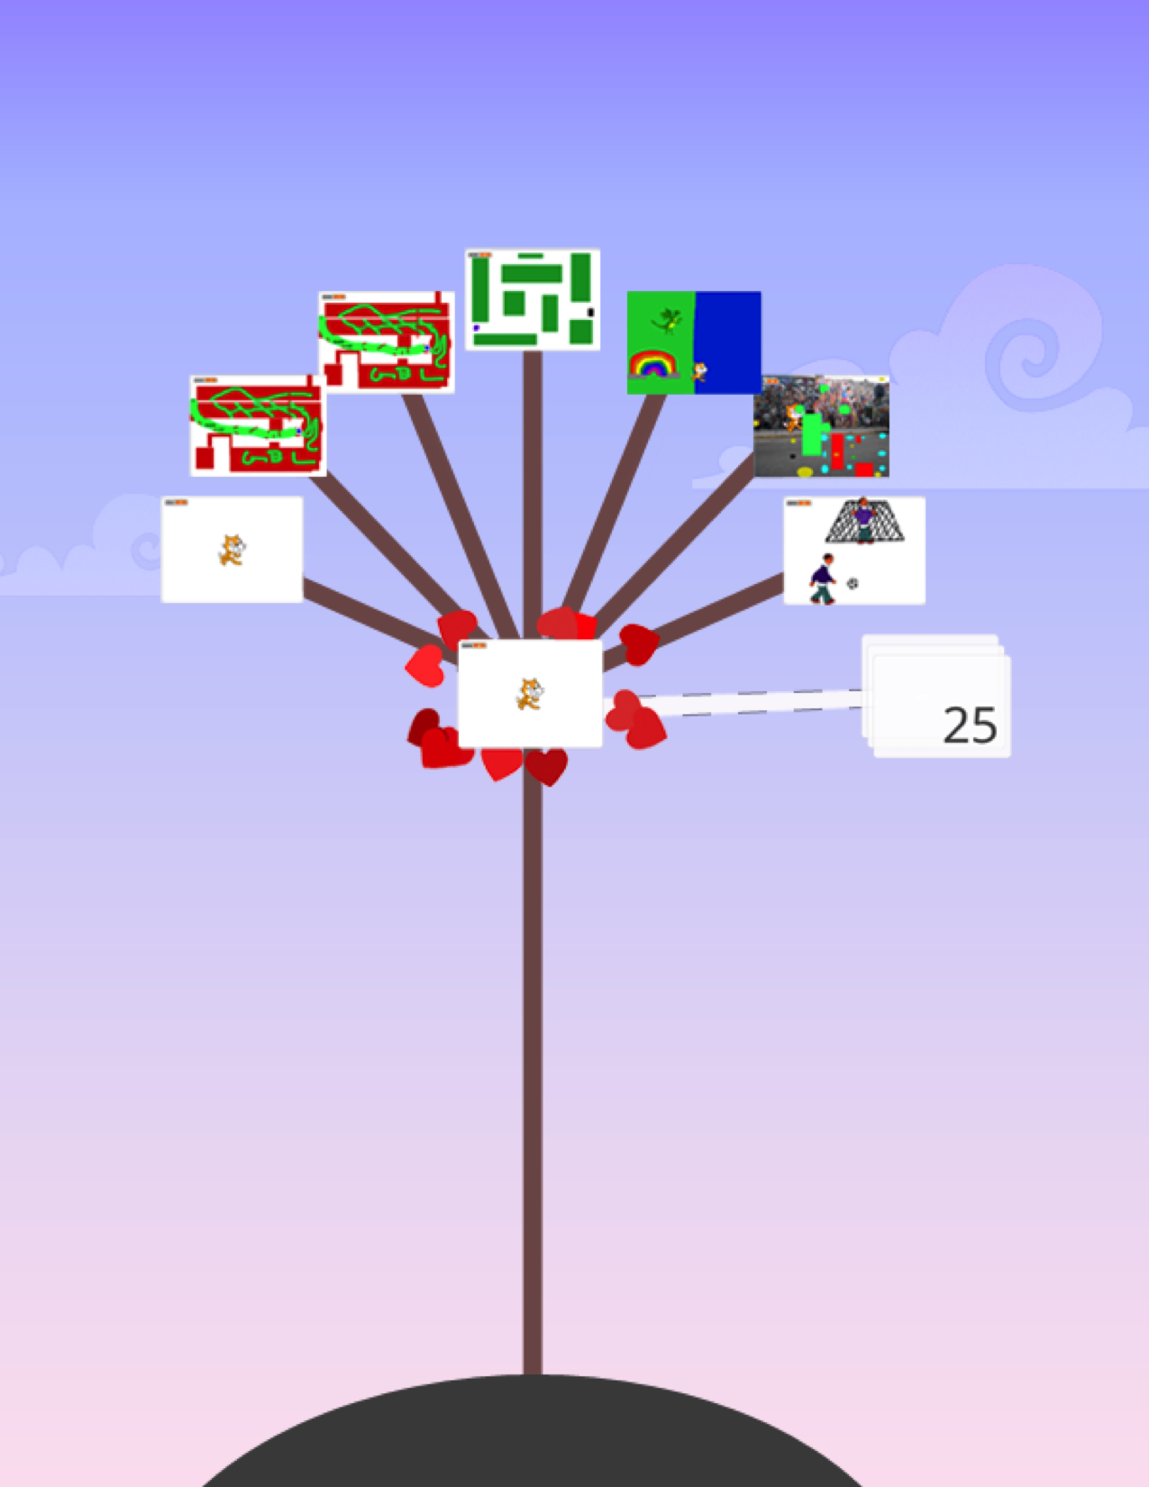
Notes:
<numéro>

Slide 8
ADVANCED
CONCEPTS
OBJECTIVES
By completing this activity, students will:
gain more fluency with computational concepts (events, parallelism, data) and practices (experimenting and iterating, testing and debugging, reusing and remixing, abstracting and modularizing) by creating a project exploring video sensing or cloning
UNIT 5 ACTIVITY
_{SUGGESTED TIME}
30–45 MINUTES
ACTIVITY DESCRIPTION
RESOURCES
Use the Advanced Concepts, Video Sensing examples, and Cloning examples studios to show examples and help students get familiar with blocks that control video sensing and cloning. Optionally, have the Advanced Concepts handout available to guide students.
Give students time to explore the code of example programs to create a project that experiments with one or more of the advanced concepts (video sensing, cloning).
Encourage students to share their explorations with others. We suggest hosting design demo presentations. Optionally, have students add their projects to the Advanced Concepts studio or a class studio.
Ask students to think back on the design process by responding to the reflection prompts in their design journals or in a group discussion.
Advanced Concepts studio
http://scratch.mit.edu/studios/221311
Video Sensing handout
Video Sensing examples studio
http://scratch.mit.edu/studios/201435
Cloning handout
Cloning examples studio
http://scratch.mit.edu/studios/201437
REFLECTION PROMPTS
Which advanced concept(s) did you choose to explore?
What was your strategy for learning more about the concept(s) you selected?
REVIEWING STUDENT WORK
Do projects explore one or more of the advanced concept(s)?
NOTES
NOTES TO SELF
Students who want to explore the video sensing feature will require a computer with a webcam.
Remind students that the backpack tool can be used to borrow and remix code from example projects.
96
Notes:
<numéro>

Slide 9
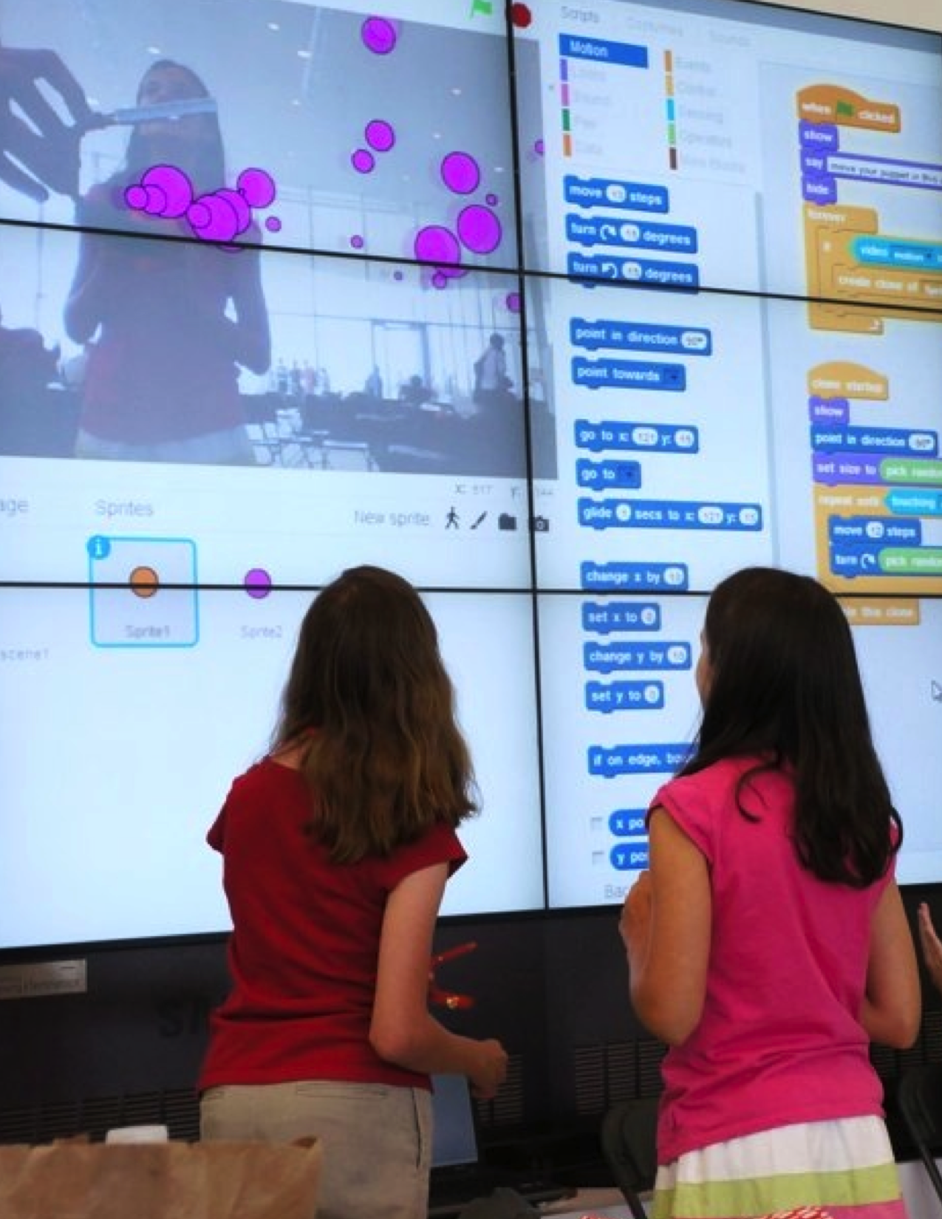
Notes:
<numéro>

Slide 10
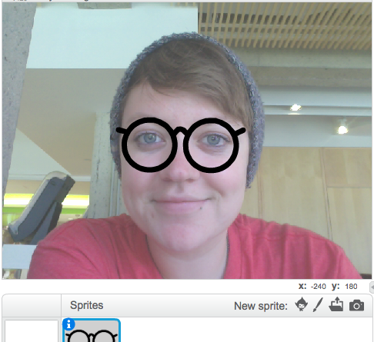
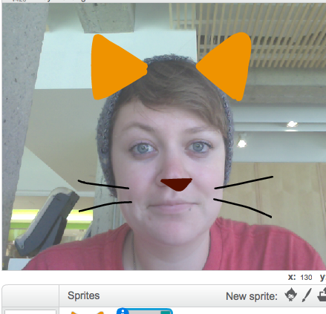
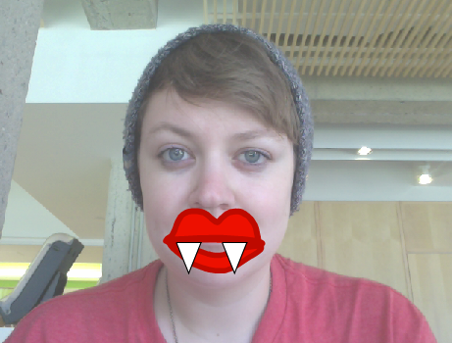
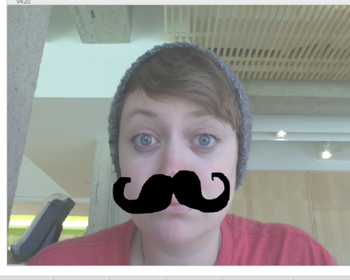
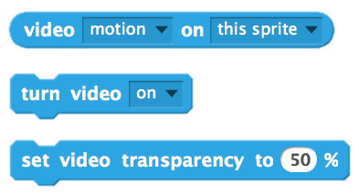
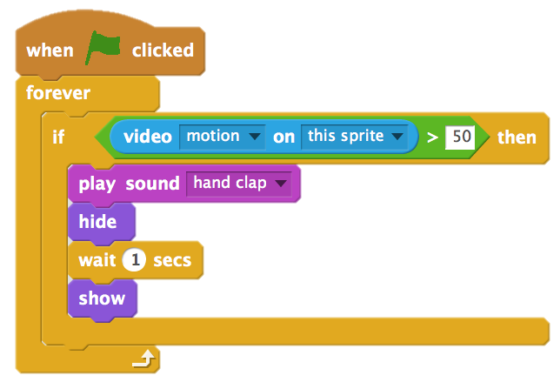
VIDEO SENSING
HOW CAN YOU USE VIDEO SENSING IN YOUR SCRATCH PROJECTS?
Did you know that you can make your Scratch projects interactive through a webcam? Explore this advanced Scratch concept by creating a project that incorporates the video sensing feature.
START HERE
Open an existing Scratch project or start a new project to add video sensing.
Check out blocks for video sensing in the Sensing category.
Experiment with video on, turn video, and set video transparency to blocks to program your project to sense video motion.
THINGS TO TRY
FINISHED?
Make sure your webcam is connected! Test it out using the turn video on block.
If you’re feeling a little stuck, that’s okay! Explore some of the other projects in the Video Sensing studio to see how they use the video blocks or use the Tips Window to learn more about video sensing.
Add your project to the Advanced Concepts studio: http://scratch.mit.edu/studios/221311
Add video sensing to one of your past projects!
Help a neighbor!
Remix a project in the Video Sensing studio.
Notes:
<numéro>

Slide 11

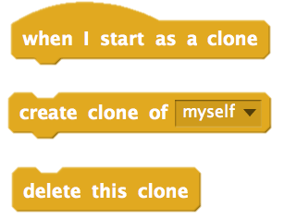
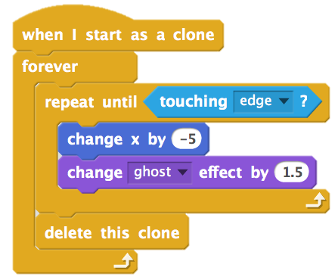
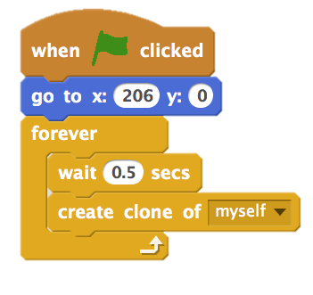
CLONING
HOW CAN YOU USE CLONING IN YOUR SCRATCH PROJECTS?
Cloning is an easy way to create multiples of the same sprite. You can use cloning to make many objects and create cool effects in a project.
Explore this advanced Scratch concept by creating a project that incorporates the cloning feature.
START HERE
Open an existing Scratch project or start a new project to experiment with cloning.
Check out blocks for cloning in the Control category.
Experiment with the blocks to create clones of your sprite. Define behaviors for what your cloned sprites will do.
THINGS TO TRY
FINISHED?
If you can’t see your clone initially, check if the original sprite is in the same location – it might be covering the clone! Program your original sprite or the clone to move or go to different locations so you can see them.
Stuck? That’s okay! Explore some of the other projects in the Cloning Studio to see how they use cloning or search in the Tips Window to learn more about the Create Clone and When I start as a Clone blocks.
Add your project to the Cloning studio:
http://scratch.mit.edu/studios/201437
Add cloning to one of your past projects!
Help a neighbor!
Remix a project in the Cloning studio.
Notes:
<numéro>

Slide 12
HARDWARE & EXTENSIONS
OBJECTIVES
By completing this activity, students will:
be introduced to various hardware extensions that connect the digital world of Scratch with the physical world
UNIT 5 ACTIVITY
_{SUGGESTED TIME}
45–60 MINUTES
ACTIVITY DESCRIPTION
RESOURCES
(IMPORTANT: This activity requires access to one or more of these hardware products.) Introduce students to ways Scratch can connect to other technologies and hardware extensions including the LEGO WeDo, MaKey MaKey, and PicoBoard. Optionally, show examples from the How can I connect Scratch with other technologies? video playlist.
Divide students into small groups of 2-4 people. Give the groups time to explore creating a Scratch project that incorporates a physical world component using one or more available hardware extensions.
Allow each group to share their creations with others. We suggest facilitating a gallery walk or feedback fair.
Ask students to think back on the design process by responding to the reflection prompts in their design journals or in a group discussion.
LEGO WeDo construction set
http://bit.ly/LEGOWeDo
MaKey MaKey
http://makeymakey.com
PicoBoard
https://www.sparkfun.com/products/10311
How can I connect Scratch with other technologies? videos
http://bit.ly/hardwareandextensions
REFLECTION PROMPTS
Which hardware or extension did you explore?
How did you incorporate the digital and the physical?
What was difficult?
What was surprising?
REVIEWING STUDENT WORK
Does the work have a digital and a physical component?
NOTES
NOTES TO SELF
Make this a group-wide activity! Using the LEGO WeDo and Scratch, challenge students to connect their projects to create a chain of reactions in the style of a Rube Goldberg machine. See this video for an example:
http://bit.ly/ScratchChainReaction
Activate the Scratch blocks that control hardware extensions by clicking on the Add an Extension button located under the More Blocks category in the Scratch project editor.
100
Notes:
<numéro>

Slide 13
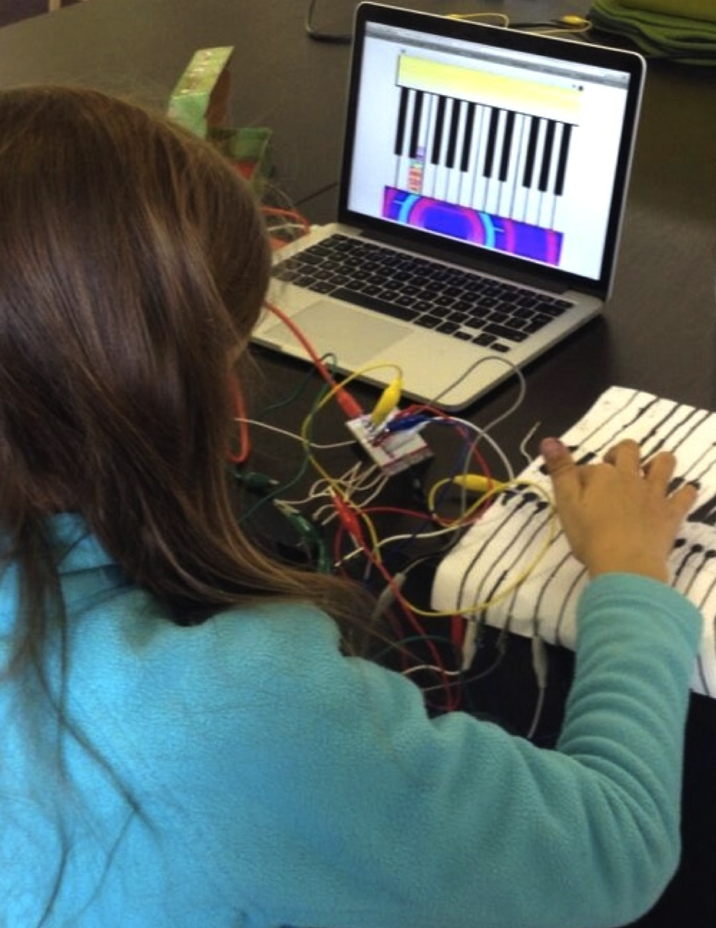
Notes:
<numéro>

Slide 14
ACTIVITY
DESIGN
OBJECTIVES
By completing this activity, students will:
design an activity or resource for supporting others in learning more about Scratch and computational creativity
UNIT 5 ACTIVITY
_{SUGGESTED TIME}
30–45 MINUTES
ACTIVITY DESCRIPTION
RESOURCES
Let students experience what it’s like to be in your teaching shoes! Challenge students to create, remix, or reimagine an activity or resource designed to support others' explorations of creative computing. Optionally, have the Activity Design handout available for additional support.
Help students brainstorm and imagine different kinds of creative learning experiences. Optionally, review example project ideas and activities from this guide, or encourage students to explore the Scratch Cards resource and Scratch Design Studio list for inspiration. Then, give students time to design their own learning activity or resource.
Give students opportunities to test out their activity or resource with learners. Encourage them to share their activity or resource with family or friends, or invite students to be peer mentors for other classes, clubs, or events.
Ask students to think back on the design process by responding to the reflection prompts in their design journals or in a group discussion.
Activity Design handout
Scratch Cards
http://scratch.mit.edu/help/cards
Scratch Design Studio list
http://scratch.mit.edu/users/ScratchDesignStudio/
REFLECTION PROMPTS
Who do you envision using your activity or resource?
What do you hope people will learn from using your activity or resource?
What challenges might learners experience in doing the activity or using the resource? How might you further support them in dealing with these challenges?
REVIEWING STUDENT WORK
Does the activity or resource facilitate an introduction or exploration into creative computing? What feedback can you offer the student?
NOTES
NOTES TO SELF
Students particularly interested in supporting others’ learning can be great candidates for becoming peer mentors during class or at an afterschool or lunchtime Scratch Club.
102
Notes:
<numéro>

Slide 15
ACTIVITY
DESIGN
NAME: _________________________________________________
How can you help others learn more about Scratch and creative computing? Design an activity that helps other people learn Scratch. It can be an off-computer activity (like Creature Construction), project idea (like Build-a-Band), or challenge activity (like Debug It!). You could even develop a new type of activity or handout! Brainstorm using the questions below, and then use the activity and handout planners to give more detail.
WHO IS THIS FOR?
Who is your audience? Who do you want to help learn more about Scratch and creative computing?
WHAT WILL THEY LEARN?
What are the learning goals? What new things do you hope people will learn from using your activity?
WHAT DO THEY NEED?
TIPS & TRICKS
What supplies will people need? What other types of support will help people successfully engage in your activity?
Notes:
<numéro>

Slide 16
(TITLE)
(2 LEARNING GOALS)
OBJECTIVES
By completing this activity, learners will:
MY ACTIVITY
_{SUGGESTED TIME}
__–__ MINUTES
ACTIVITY DESCRIPTION
RESOURCES
(PROJECT INSTRUCTIONS)
What will learners create? How will they do this?
How will learners share their work with others?
How will learners reflect on their designs?
(2 PROJECT RESOURCES - studios, handouts, etc.)
REFLECTION PROMPTS
(3 REFLECTION QUESTIONS)
REVIEWING STUDENT WORK
(2 WAYS TO CHECK IF A LEARNER COMPLETED THE ACTIVITY)
NOTES
NOTES TO SELF
(TIPS AND TRICKS)
Notes:
<numéro>

Slide 17

(TITLE)
(PROJECT PICTURE)
(PROJECT OVERVIEW)
(PROJECT DESCRIPTION)
START HERE
(PROJECT INSTRUCTIONS)
(ILLUSTRATED PROJECT INSTRUCTIONS)
THINGS TO TRY
FINISHED?
(3 THINGS TO DO IF THEY GET STUCK)
(3 THINGS TO DO IF THEY HAVE EXTRA TIME)
Notes:
<numéro>

Slide 18

MY DEBUG IT!
OBJECTIVES
By completing this activity, students will:
become more fluent with computational practices (experimenting and iterating, testing and debugging, reusing and remixing, abstracting and modularizing) by designing a debugging challenge
UNIT 5 ACTIVITY
_{SUGGESTED TIME}
15–30 MINUTES
ACTIVITY DESCRIPTION
ACTIVITY DESCRIPTION
ACTIVITY DESCRIPTION
RESOURCES
Optionally, have the My Debug It! handout available to guide students during the activity.
Give students the opportunity to create their own debugging challenge for others to solve. Bugs can focus on a specific computational concept, Scratch block, interaction, or some other programming challenge. Encourage students to take inspiration from their own experiences of getting stuck and unstuck while developing Scratch projects.
Let students swap and try testing and debugging one another’s buggy projects. Optionally, have students add their debug-it program to the My Debug It! studio or a class studio.
Ask students to reflect back on their problem-creating approaches by responding to the reflection prompts in their design journals or in a group discussion.
My Debug It! handout
My Debug It! studio
http://scratch.mit.edu/studios/475637
REFLECTION PROMPTS
What was the problem?
Where did your inspiration come from?
How did you imagine others investigating and solving the challenge?
Did others have alternative approaches to finding and fixing the problem than what you expected? What were their strategies?
REVIEWING STUDENT WORK
Do projects include a debugging challenge to solve?
What different testing and debugging strategies did students employ?
NOTES
NOTES TO SELF
Remind students to include a challenge description in the notes of the project page on the Scratch website.
Got extra time or need a warm-up activity? Let students exercise their problem-seeking and problem-solving skills on other contributed debug-it programs in the My Debug It! studio.
106
Notes:
<numéro>

Slide 19

MY DEBUG IT!
IT’S TIME TO DESIGN YOUR OWN DEBUG IT PROGRAM. WHAT WILL YOU CREATE?
In this activity, you will create your own Debug It! challenge for others to investigate, solve, and remix.
START HERE
PLANS FOR MY DEBUG IT!
Reflect back on the different kinds of bugs you’ve encountered in creating and debugging your own projects.
Generate a list of possible debugging challenges you could create. A Debug It! can focus on a specific concept, block, interaction, or some other programming challenge.
Build your Debug It! program.
NOTES
TO SELF
FINISHED?
Add your debugging challenge to the My Debug It! studio: http://scratch.mit.edu/studios/475637
Swap Debug It! programs with a neighbor and try to solve each other’s buggy programs.
Help a neighbor.
Try debugging other programs in the My Debug It! studio.
Notes:
<numéro>

Slide 20
108

